Slide 1
Disabled Faces, Able Spaces
Josh Welhener, Greene County Board of Developmental Disabilities
Notes:
Credit: Carolyn Finney, Author of Black Faces, White Spaces

Slide 2
A little background
My coworker and I organize a group called All Hands In.
Social Capital development is the name of the game.
We are trying to overcome the 33% employment rate among the developmental disability community.
Low employment rates lead to a cascade of negative consequences concerning community connections and inclusion.

Slide 3
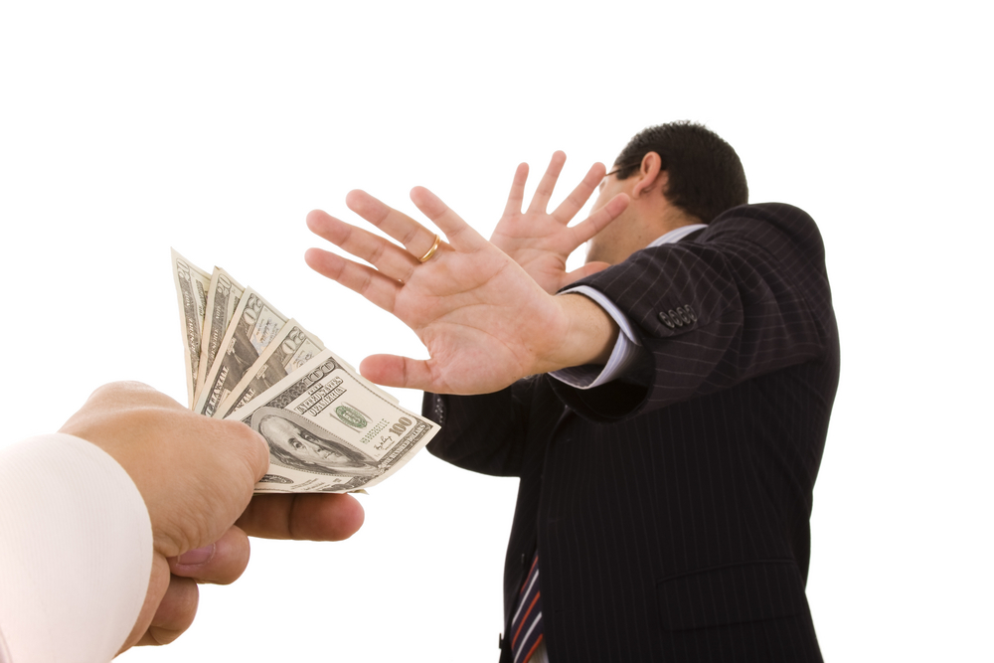
Social Capital is expensive
Time>Money
People will often give money before investing their time.
We host many events that are open to the entire community and are mostly ignored.
Relationships are our most precious commodity.

Slide 4
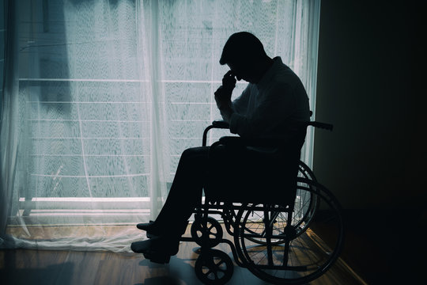
How does this relate to you?
Accessibility is about way more than wheelchair ramps.
True accessibility= having a reason to be there.
Bike paths, curb cuts, and safe crosswalks don’t mean as much without purpose.

Slide 5
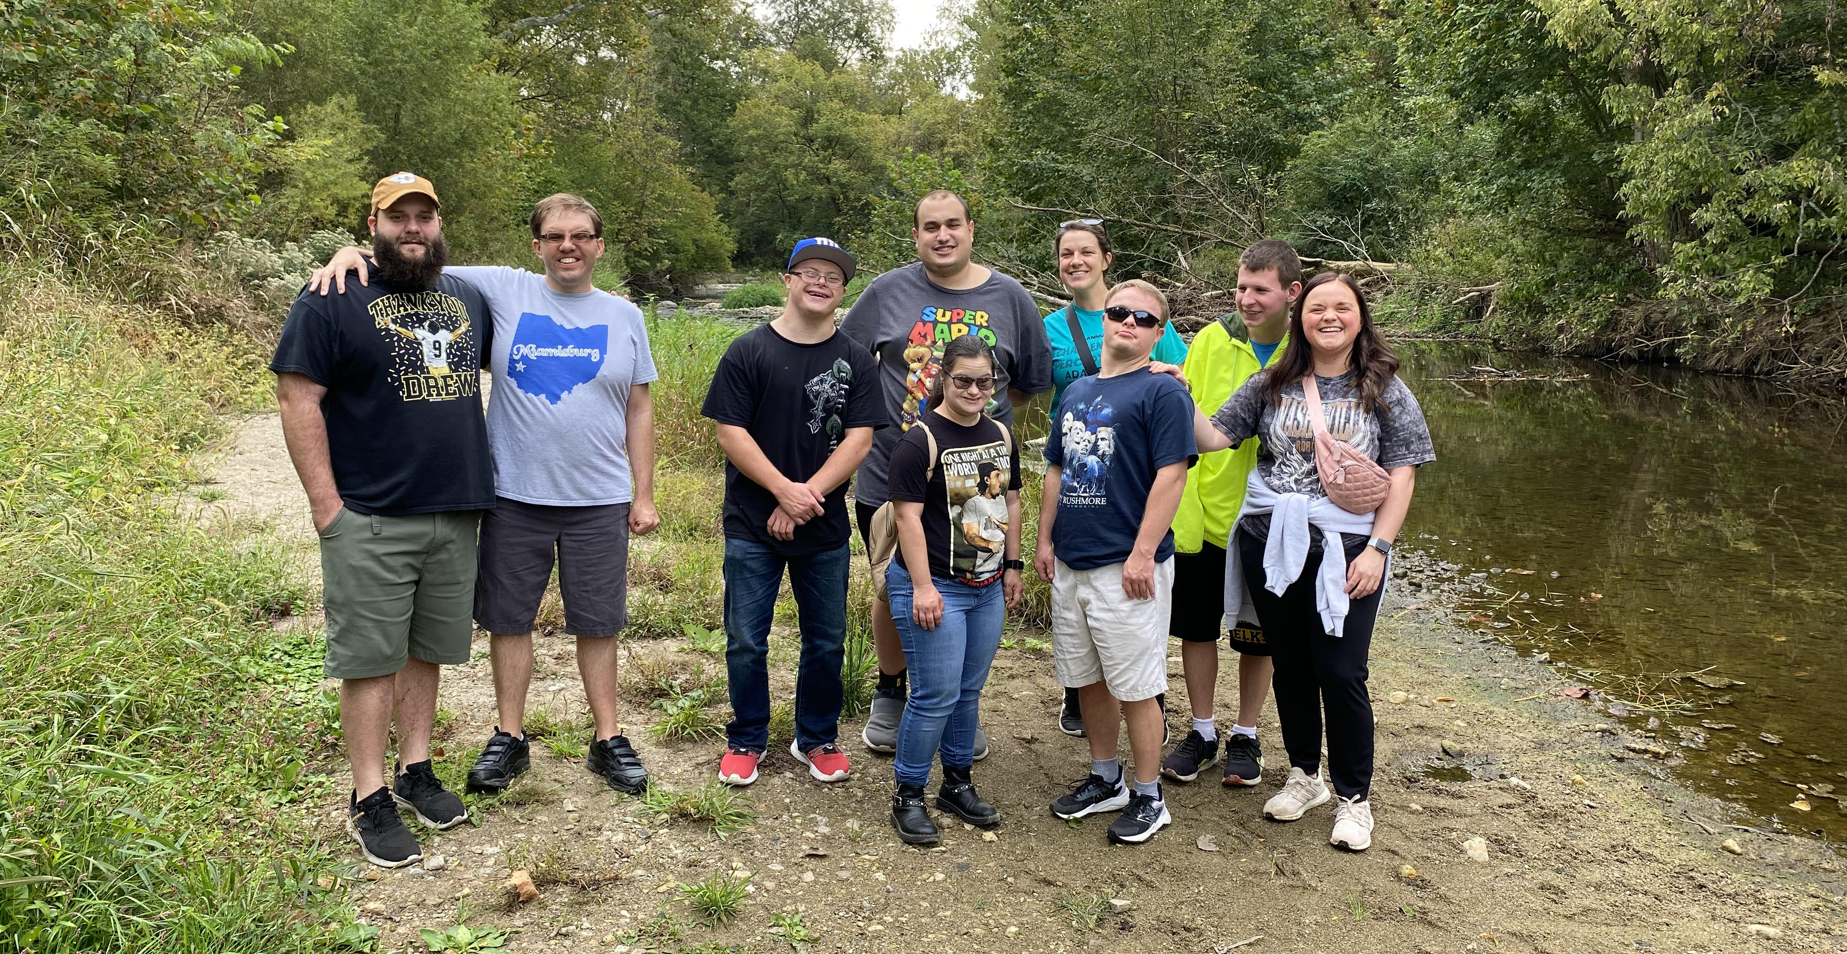
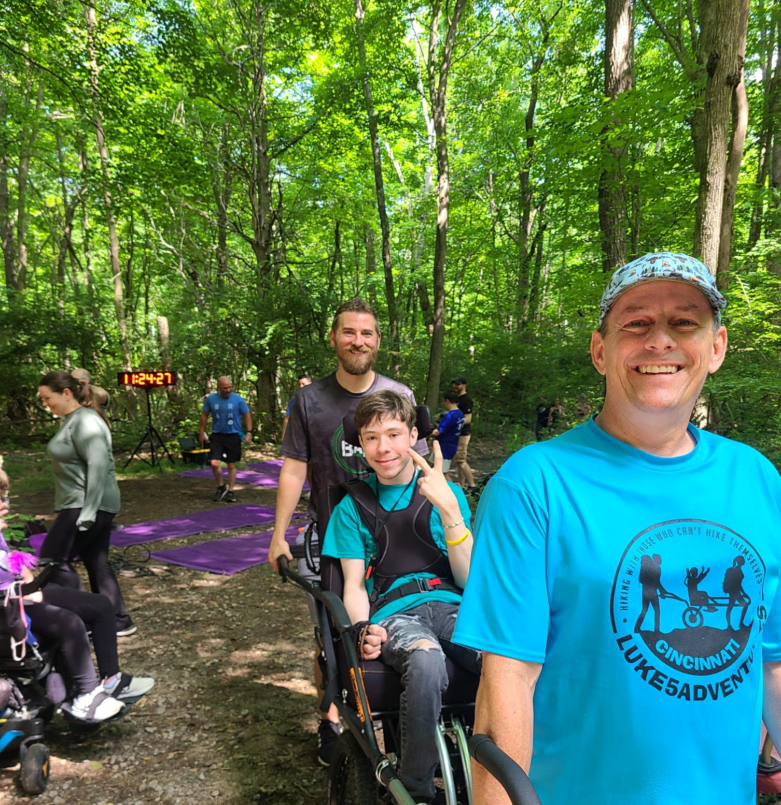
So what are we asking for?
We need community groups to join us
We are tired of segregated DD events
We want our folks to have access to the community without needing DD supports.

Slide 6
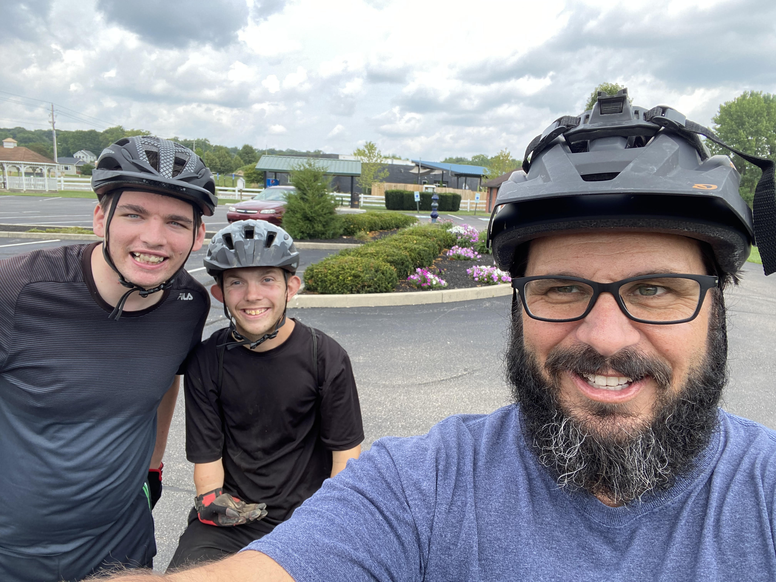
Do you want to join us?
Josh Welhener
Greene County Board of Developmental Disabilities
937-477-4286
jwelhener@greenedd.org
https://www.facebook.com/allhandsingcbdd/

